Slide 1
Docker Networking
Sameer Zulfi

Slide 2
No Network means No App
In any application, network is basic.
Docker runs applications inside of containers
These Containers needs to communicate over lot of different networks
For ex :
Containers <-> Containers communication
Connecting to existing VLAN
Connecting to existing systems such as VMs and physicals

Slide 3
What are we going to cover???
Theory
Single-host bridge networks
Multi-host overlay networks
Connecting to existing networks
Service Discovery
Ingress Networking

Slide 4
The Theory
3 Major Components describes Docker Networking.
1. Container Network Model – CNM
2. libnetwork
3. Drivers
CNM is the fundamental and core to build the networking. Like DNA
Libnetwork is the real-world implementation. It is written in Go
Drivers extend the model by implementing specific network topologies

Slide 5
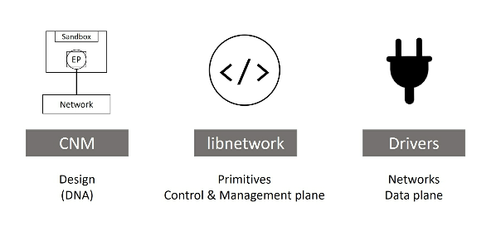
High level of all 3 components

Slide 6
CNM
Everything starts with a design
Design guide for Docker Networking is CNM.
Under CNM, we have 3 building blocks :
1. Sandboxes
2. Endpoints
3. Networks

Slide 7
A Sandbox is an isolated network stack. Includes
Ethernet interfaces, ports, routing tables and DNS config
An EndPoints are virtual network interfaces. Eg., veth. Endpoints are responsible for making connections.
So job os the Endpoint is to connect a Sanbox to a network.
Networks are software implementation of an 802.1d bridge ( more commonly known as Switch).

Slide 8
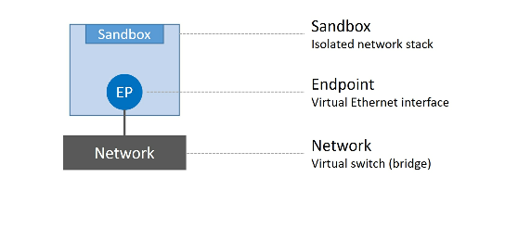
Sandbox, Endpoint, Network

Slide 9
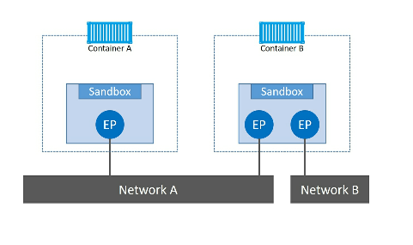
With Containers how it looks ??
Endpoints behave like regular network adapters.

Slide 10
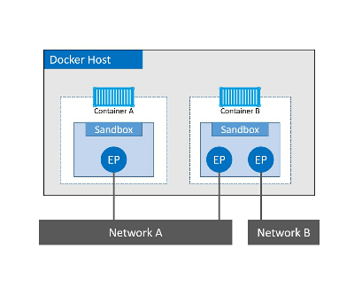
Let’s add Docker Host to the diagram
Although both containers
Running on same host, but
Network stacks are completely
isolated

Slide 11
What is libnetwork?
CNM was the design doc, but real implementation is done by libnetwork.
This implements service discovery, ingress-based containers load balancing and network control plane and management plane functionality.

Slide 12
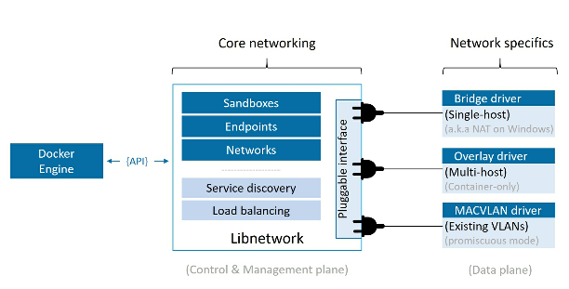
What is Drivers???
If libnetwork implements the control plane and management plane functions, then drivers implement the data plane.
So Connectivity is all handled by Drivers.

Slide 13
Docker ships with several built-in drivers known as native-drivers or local drivers.
On Linux – they include bridge, overlay and macvlan.
On Windows – they include nat, overlay and transparent and l2bridge.

Slide 14
Single-host bridge networks
Simlest type of docker network is the single host bridge networks.
Name itself tell us two things :
Single-host means only on One Single Docker Host machine and can connect containers that are on the same host.
Bridge means it’s an implementation of an 802.1d bridge ( layer2 switch )

Slide 15
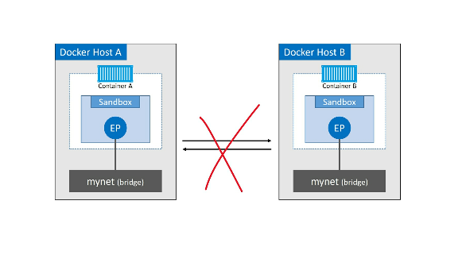
Two docker hosts with identical local bridge neworks called “mynet”. Even though
The networks are identical, they are independent isolated networks.

Slide 16
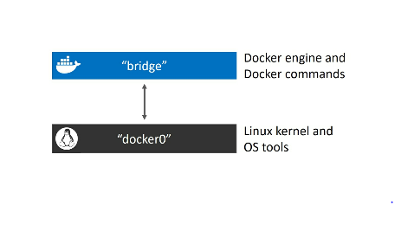

Docker network
Docker network ls
Docker network inspect bridge
Ip link show docker0

Slide 17
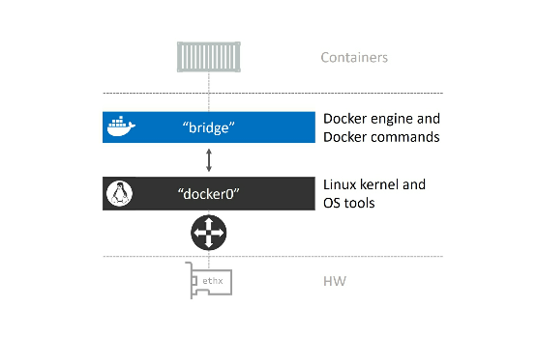
Big picture

Slide 18
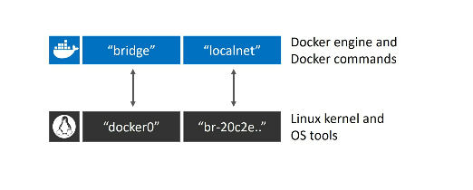
Docker network create –d bridge localnet
Brctl show
At this point the diagram looks like this :

Slide 19
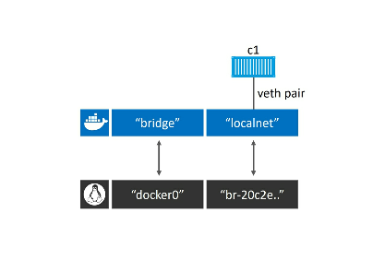
docker container run -d --name c1 --network localnet alpine sleep 1d
The above container will be on the localnet network
Docker network inspect localnet
Let’s run brtcl show again and will see that interface has been connected

Slide 20
Let’s test something
docker container run -it --name c2 --network localnet alpine sh
You will be inside the container..
Ping c1
You will get a reply

Slide 21
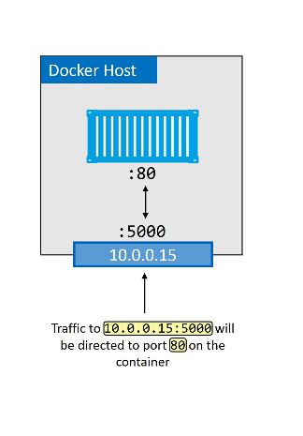
We can do port mapping

Slide 22
Let’s see how to perform port mapping
docker container run -d --name web --network localnet --publish 5000:80 nginx
Verify the ports.
Docker port web
Publicip:5000

Slide 23
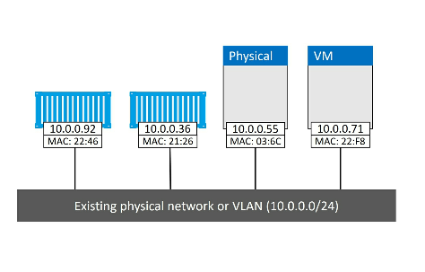
Connecting to existing networks
The build-in MACVLAN driver – transparent driver on windows

Slide 24
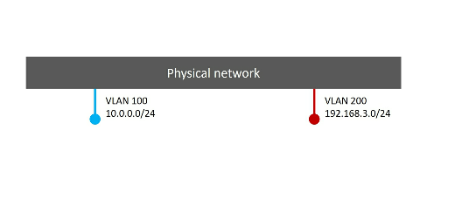
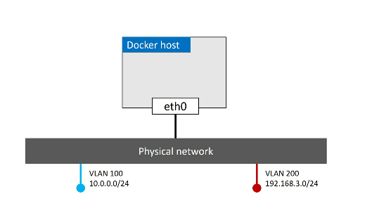
Assume we have two VLANs
VLAN 100: 10.0.0.0/24
VLAN 200: 192.168.3.0/24
Next we add a docker host
And connect it to the network

Slide 25
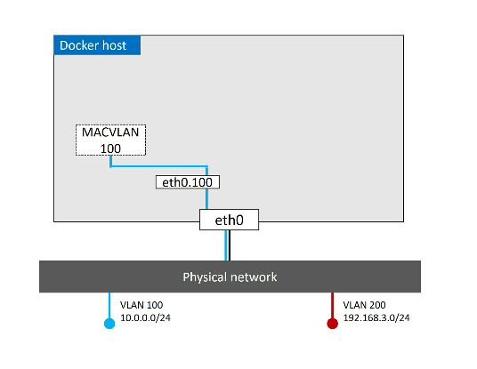
Now our requirement is to connect a container into VLAN 100.
To do this, we create new Docker network with macvlan driver.
Command is “docker network create –d macvlan –-subnet=10.0.0.0/24 –ip-range=10.0.0.0/25 –gateway=10.0.0.1 –o parent=eth0.100 macvlan100

Slide 26
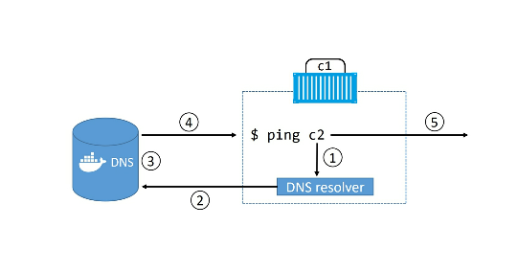
Container and Service Logs for Troubleshooting
If you issues between two containers, better check the logs
In Ubuntu, type “journalctl –u docker.service”
Next is Service Discovery :
It allows all containers and swarm services to locate each other by name.
They should be on the same network
If two containers are on the diff network,
This will not able to resolve

Slide 27
Ingress Load Balancing
Swarm supports two publishing modes
Ingress mode(default) and Host mode
Services published via ingress mode can be accessed rom any node in the swarm, even nodes not running service replica.
Services published via host mode can only be accessed via nodes running service replicas.

Slide 28
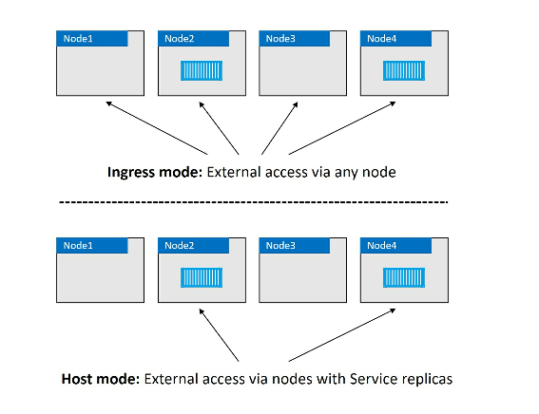

Slide 29
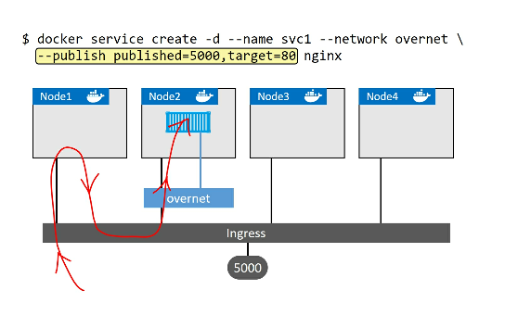
How Ingress Mode works

Slide 30
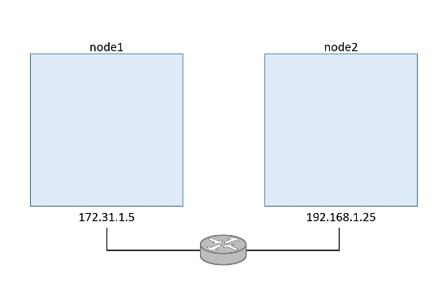
Docker Overlay Networking
How to communicate from one host to another host
In March 2015, acquired a container network startup called “Socket Plane”
Let’s build and test a Docker OverLay Network in Swarm mode

Slide 31
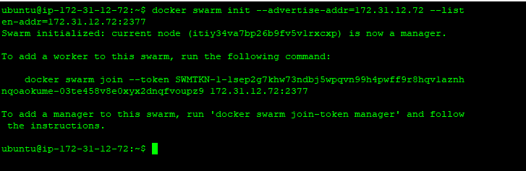
Build a Swarm
On Node1:
On Node2: Join as a worker

Slide 32
Create a new Overlay Network
Please execute the below command
Type “docker network ls”

Slide 33
Attach a service to the overlay network
On Node1:
Docker service create –name test –network uber-net –replicas 2 Ubuntu sleep infinity

